Slide 1




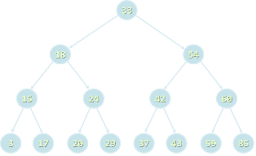

Collection Data Structures and Libraries
.NET Collections, Wintellect Power Collections, C5 Collections
Advanced DS and Libraries
SoftUni Team
Technical Trainers
Software University
http://softuni.bg

Slide 2

Table of Contents
Collection Data Structures
Standard .NET Data Structures
Special .NET Collections
Wintellect Power Collections Library
Installation / NuGet Package
Power Collection Classes
Implementing Priority Queue
C5 Collections Library

Slide 3
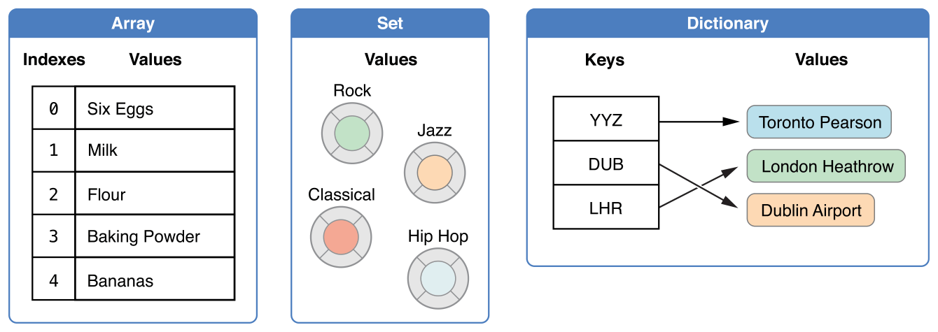
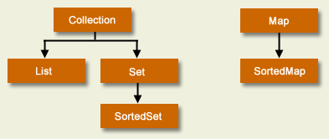
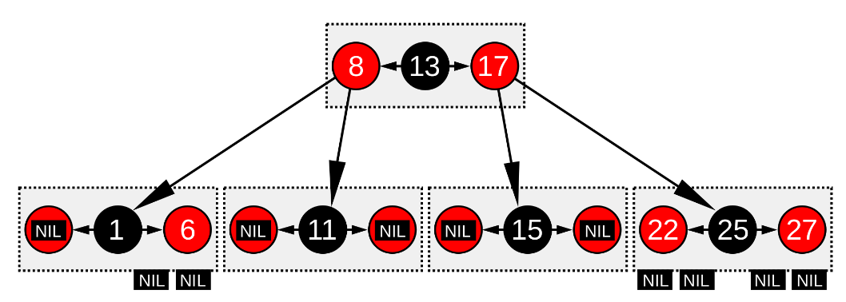
Collection Data Structures
Classical Collections

Slide 4


Classical Collection Structures
Linear collection structures
Lists: array-based list, linked list
Stacks: array-based stack, linked stack
Queues: array-based circular queue, linked queue
Deque: doubly-ended queue (array-based and linked)
Dictionaries (maps / associative arrays)
Hash-table based dictionary
Balanced tree-based ordered dictionary
Multi-dictionary (single key, multiple values)

Slide 5


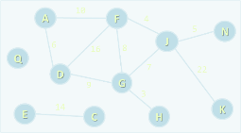
Classical Collection Structures (2)
Sets and multi-sets (bags)
Sets – hash-table-based set, ordered tree-based set
Bag – hash-table-based bag, ordered tree-based bag
Priority queues / heaps
Special tree structures
Trie, suffix tree, interval tree, rope
Graphs
Directed / undirected, weighted / un-weighted, connected / non-connected, flow networks, …

Slide 6
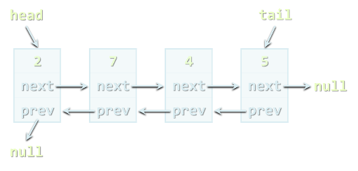
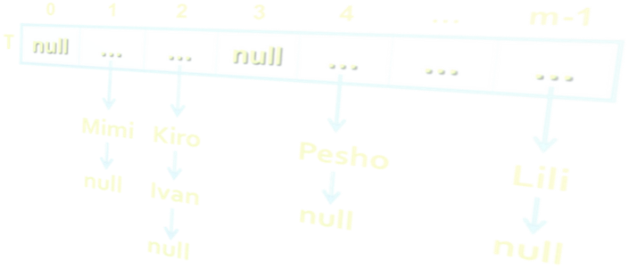
Standard .NET Data Structures
Built-in .NET Data Structure Implementations

Slide 7

Standard .NET Data Structures
Linear structures
Lists: List<T>, LinkedList<T>
Stacks and queues: Stack<T>, Queue<T>
Dictionaries (maps)
Dictionary<K,V> and SortedDictionary<K,V>
No multi-dictionary class in .NET, use Dictionary<K, List<V>>
Balanced search tree structures
SortedSet<T>, SortedDictionary<K,V>, SortedDictionary<K, List<V>>

Slide 8
Standard .NET Data Structures (2)
Sets and bags
Sets – HashSet<T>, SortedSet<T>
Bag – no standard .NET class
Priority queues / heaps → no
Special tree structures → no
Trie, suffix tree, interval tree
Graphs → no
Directed / undirected, weighted / un-weighted, connected/ non-connected, …

Slide 9
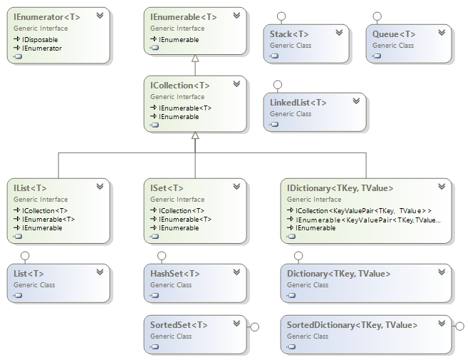
.NET Generic Collections

Slide 10
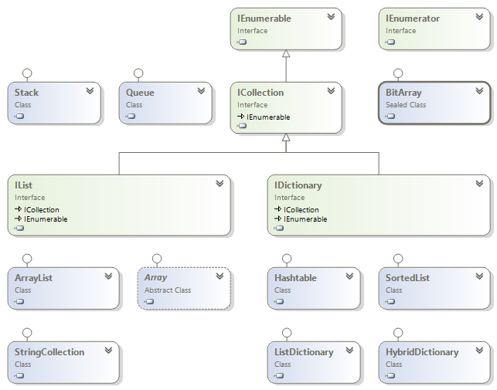
.NET Untyped Collections

Slide 11
Special .NET Collections
Collection<T>
Inheritable IList<T>, virtual Add() / Remove()
ObservableCollection<T>
Event CollectionChanged
IReadOnlyCollection<T>
Supports only Count and GetEnumerator()
IReadOnlyList<T>
Supports only Count, [] and GetEnumerator()
Concurrent collections (thread-safe)
BlockingCollection<T>, ConcurrentBag<T>, …

Slide 12
Observable Collection – Example
static void Main()
{
var items = new ObservableCollection<string>();
items.CollectionChanged += items_CollectionChanged;
items.Add("new item");
items.Add("another item");
items[1] = "new value";
items.RemoveAt(0);
}
static void items_CollectionChanged(object sender,
NotifyCollectionChangedEventArgs e)
{
Console.WriteLine(e.Action);
}

Slide 13
BlockingCollection<T>
BlockingCollection<T> is a thread-safe blocking queue
Implements the "Producer-Consumer" pattern
The blocking collection (queue) has optional maximum capacity
Insert / take block when collection is empty or full
Non-blocking insert / take "try" operations with timeout
Example:
Implement a task scheduler with multiple executors
Producers can request many tasks, while executors are limited

Slide 14
BlockingCollection<T> – Example
static BlockingCollection<string> tasks =
new BlockingCollection<string>();
private static void Consumer()
{
while (true)
{
var task = tasks.Take(); // Blocks on empty queue
Console.WriteLine("Executing task {0} ...", task);
Thread.Sleep(2000);
Console.WriteLine("Task {0} finished.", task);
}
}
// Example continues

Slide 15
BlockingCollection<T> – Example (2)
static void Main()
{
// Start 3 consumers (task executors)
for (int i = 0; i < 3; i++)
(new Thread(Consumer)).Start();
// Start a producer
while (true)
{
Console.WriteLine("Press [Enter] to produce new task");
Console.ReadLine();
var task = "Task" + DateTime.Now.Ticks;
tasks.Add(task);
}
}

Slide 16

Special .NET Collections
Live Demo

Slide 17

Wintellect Power Collections
Open Source C# Implementation of All Major Data Structures: Lists, Sets, Bags, Dictionaries, Sorted Sets / Bags, etc.

Slide 18
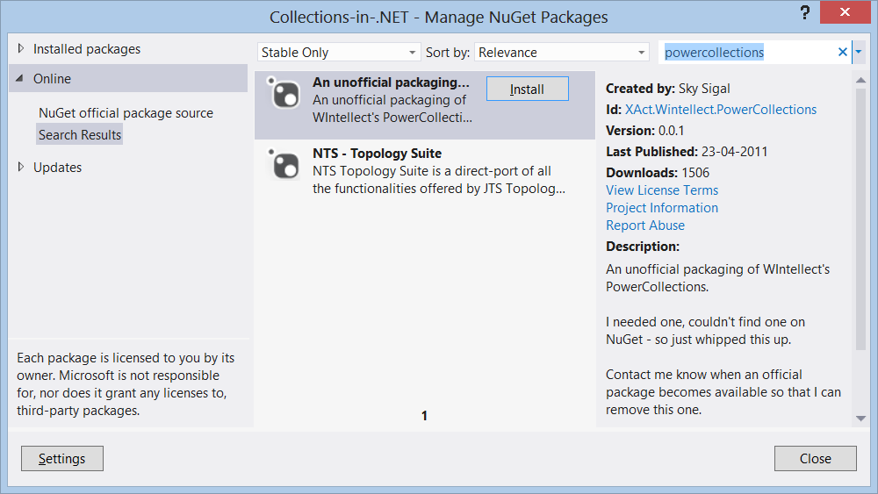
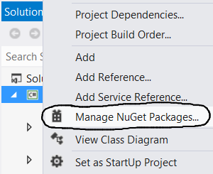
Wintellect Power Collections
Wintellect Power Collections
Powerful open-source data structure library: http://powercollections.codeplex.com
Installing Power Collections in Visual Studio
Use the NuGet package manager

Slide 19

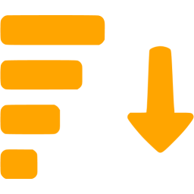
Power Collections Classes
Bag<T>
A bag (multi-set) based on hash-table
Unordered collection (with duplicates)
Add / Find / Remove work in time O(1)
T should provide Equals() and GetHashCode()
OrderedBag<T>
A bag (multi-set) based on balanced search tree
Add / Find / Remove work in time O(log(N))
T should implement IComparable<T>

Slide 20
Bag<T> – Example
Console.Write("Bag of Integers: ");
var bagOfInts = new Bag<int>();
bagOfInts.Add(3);
bagOfInts.Add(5);
bagOfInts.Add(5);
bagOfInts.Add(5);
bagOfInts.Add(10);
bagOfInts.Add(20);
bagOfInts.Add(20);
bagOfInts.Remove(5);
bagOfInts.RemoveAllCopies(20);
bagOfInts.UnionWith(new Bag<int>() { 3, 3, 4, 4, 5, 5 });
Console.WriteLine(bagOfInts);
// Bag of Integers: {10,4,4,5,5,3,3}

Slide 21
OrderedBag<T> – Example
Console.Write("OrderedBag of Integers: ");
var bag = new OrderedBag<int>();
bag.Add(3);
bag.Add(5);
bag.Add(5);
bag.Add(10);
bag.Add(20);
bag.Add(20);
bag.Remove(5);
bag.RemoveAllCopies(20);
bag.UnionWith(new OrderedBag<int>() { 3, 3, 4, 4, 5 });
Console.WriteLine(bag); // {3,3,4,4,5,10}
Console.WriteLine("Sub-range [4...10]: " +
bag.Range(4, true, 10, true)); // {4,4,5,10}

Slide 22


Power Collections Classes (2)
Set<T>
A set based on hash-table (no duplicates)
Add / Find / Remove work in time O(1)
Like .NET’s HashSet<T>
OrderedSet<T>
A set based on balanced search tree (red-black)
Add / Find / Remove work in time O(log(N))
Like .NET’s SortedSet<T>
Provides fast .Range(from, to) operation

Slide 23
Set<T> – Example
Console.Write("Set of Integers: ");
var setOfInts = new Set<int>();
setOfInts.Add(3);
setOfInts.Add(5);
setOfInts.Add(5);
setOfInts.Add(5);
setOfInts.Add(10);
setOfInts.Add(20);
setOfInts.Add(20);
setOfInts.Remove(5);
setOfInts.UnionWith(new Set<int>() { 3, 4, 5 });
Console.WriteLine(setOfInts);
// Set of Integers: {4,10,20,5,3}

Slide 24
OrderedSet<T> – Example
Console.Write("OrderedSet of Integers: ");
var orderedSet = new OrderedSet<int>();
orderedSet.Add(3);
orderedSet.Add(5);
orderedSet.Add(5);
orderedSet.Add(5);
orderedSet.Add(10);
orderedSet.Add(20);
orderedSet.Add(20);
orderedSet.Remove(5);
orderedSet.UnionWith(new OrderedSet<int>() { 3, 4, 5 });
Console.WriteLine(orderedSet); // {3,4,5,10,20}
Console.WriteLine("Sub-range [5...20): " +
orderedSet.Range(5, true, 20, false)); // {5,10}

Slide 25


Power Collections Classes (3)
MultiDictionary<TKey, TValue>
A dictionary (map) implemented by hash-table
Allows duplicates (configurable)
Add / Find / Remove work in time O(1)
Like Dictionary<TKey, List<TValue>>
OrderedDictionary<TKey, TValue> / OrderedMultiDictionary<TKey, TValue>
A dictionary based on balanced search tree
Add / Find / Remove work in time O(log(N))
Provides fast .Range(from, to) operation

Slide 26
MultiDictionary<K, V> – Example
Console.Write("MultiDictionary<string, int>: ");
var studentGrades = new MultiDictionary<string, int>(true);
studentGrades.Add("Peter", 3);
studentGrades.Add("Peter", 4);
studentGrades.Add("Peter", 4);
studentGrades.Add("Stanka", 6);
studentGrades.Add("Stanka", 5);
studentGrades.Add("Stanka", 6);
studentGrades.Add("Tanya", 6);
studentGrades.Add("Tanya", 4);
Console.WriteLine(studentGrades);
// {Tanya->(6,4), Peter->(3,4,4), Stanka->(6,5,6)}

Slide 27
OrderedMultiDictionary<K, V> – Example
Console.WriteLine("OrderedMultiDictionary<string, int>:");
var distances = new OrderedMultiDictionary<int, string>(true);
distances.Add(149, "Plovdiv");
distances.Add(505, "Varna");
distances.Add(394, "Bourgas");
distances.Add(310, "Rousse");
distances.Add(163, "Pleven");
distances.Add(163, "Troyan");
foreach (var distanceTowns in distances)
Console.WriteLine("\t" + distanceTowns);
// [149, {Plovdiv}], [163, {Pleven,Troyan}], [310, {Rousse}],
[394, {Bourgas}] [505, {Varna}]

Slide 28

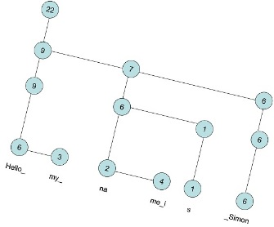
Power Collections Classes (4)
Deque<T>
Double-ended queue (deque)
BigList<T>
Editable sequence of indexed items (e.g. large string)
Like List<T> but provides
Fast Insert / Delete operations (at any position)
Fast Copy / Concat / Sub-range operations
Implemented by the data structure "Rope"
Special kind of balanced binary tree: en.wikipedia.org/wiki/Rope_(data_structure)

Slide 29
Deque<T> – Example
Console.Write("Deque<string>: ");
var people = new Deque<string>();
people.AddToBack("Kiro");
people.AddToBack("Maria");
people.AddToFront("Steve");
people.AddManyToBack(new string[] { "Ivan", "Veronika" });
Console.WriteLine(people);
// {Steve,Kiro,Maria,Ivan,Veronika}

Slide 30
BigList<T> – Example
Console.Write("BigList<int>: ");
var ints = new BigList<int>();
// var ints = new List<int>(); // List<int> → very slow!
for (int i = 0; i < 1000000; i++)
{
ints.Add(i);
}
for (int i = 0; i < 50000; i++)
{
ints.Insert(i, i);
}
Console.WriteLine(ints.Count); // 1050000

Slide 31
Wintellect Power Collections
Live Demo

Slide 32

Priority Queue
What is a "priority queue"?
Data structure to efficiently support finding the item of highest priority
Like a queue, but with priorities
The basic operations
Enqueue(T element)
Dequeue() → T
There is no build-in priority queue in .NET
See the data structure "binary heap" in Wikipedia
Can be implemented using an OrderedBag<T>

Slide 33

Sample Priority Queue Implementation
class PriorityQueue<T> where T : IComparable<T>
{
private OrderedBag<T> queue;
public int Count { get { return this.queue.Count; } }
public PriorityQueue()
{
this.queue = new OrderedBag<T>();
}
public void Enqueue(T element)
{
this.queue.Add(element);
}
public T Dequeue()
{
return this.queue.RemoveFirst();
}
}

Slide 34
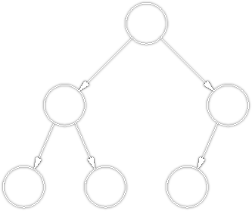
Priority Queue
Live Demo

Slide 35
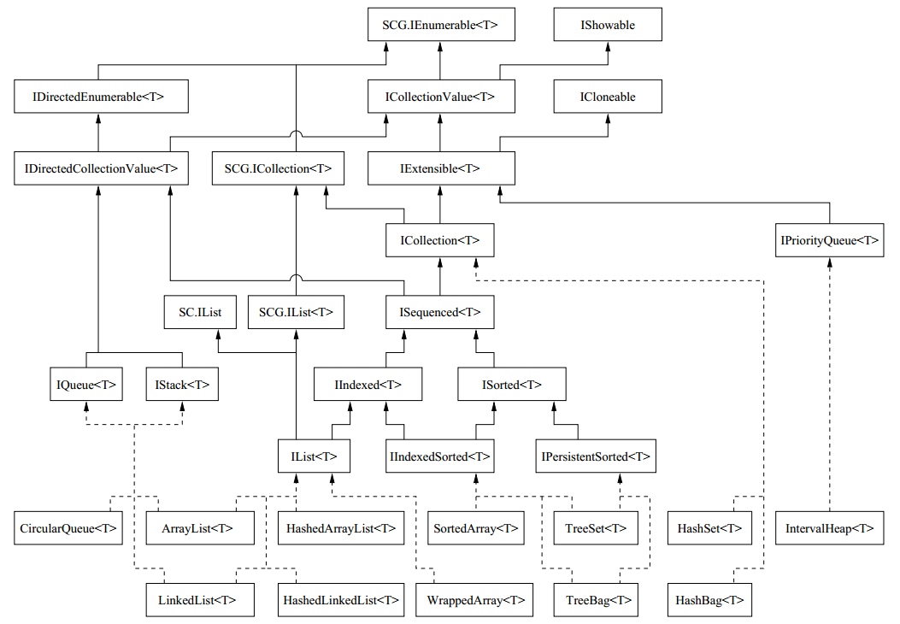
C5 Collections
Open Source Generic Collection Library for C# Developers

Slide 36


C5 Collections
What are "C5 Collections"?
C5 Generic Collection Library for C# and CLI
Open-Source Data Structures Library for .NET
http://www.itu.dk/research/c5/
Comes with a solid documentation (book): www.itu.dk/research/c5/latest/ITU-TR-2006-76.pdf
The C5 library defines its own interfaces like IEnumerable<T>, IIndexed<T>, IIndexedSorted<T>, …
Available also as NuGet package

Slide 37
C5 Collection Classes

Slide 38
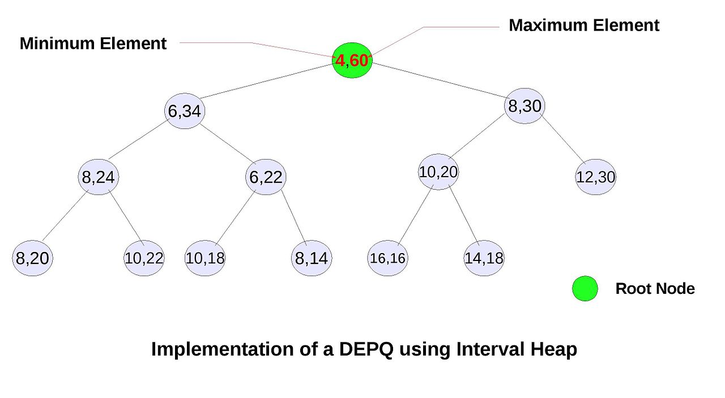
C5 Collection Classes
Classical collection classes
ArrayList<T>, LinkedList<T>, CircularQueue<T>, HashSet<T>, TreeSet<T>, HashBag<T>, TreeBag<T>
HashedArrayList<T>
Combination of indexed list + hash-table
Fast Add / Find / indexer [] → O(1)
IntervalHeap<T>
Double-ended priority queue (DEPQ)

Slide 39
C5 IntervalHeap<T> – Example
var people = new IntervalHeap<Person>();
people.Add(new Person("Nakov", 25));
people.Add(new Person("Petya", 24));
people.Add(new Person("Pesho", 25));
people.Add(new Person("Maria", 22));
people.Add(new Person("Ivan", -1));
Console.WriteLine("Min: {0}", people.FindMin()); // Ivan, -1
Console.WriteLine("Max: {0}", people.FindMax()); // Nakov, 25
while (people.Count > 0)
Console.WriteLine(people.DeleteMin());
// Ivan, -1; Maria, 22; Petya, 24; Pesho, 25; Nakov, 25

Slide 40
C5 Collections
Live Demo

Slide 41
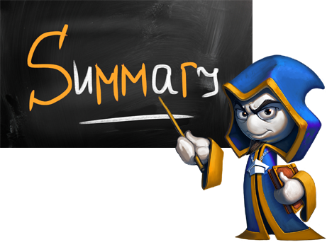
Summary
Development platforms like .NET and Java provide many collection structures out-of-the-box
Lists, dictionaries, sets, etc.
Third-party libraries provide many more collections
Heaps, ropes, suffix trees, multi-dictionaries, …
In C# / .NET use
Wintellect Power Collections
C5 Collections

Slide 42









Collection Data Structures and Libraries
https://softuni.bg/trainings/1147/Data-Structures-June-2015

Slide 43
License
This course (slides, examples, labs, videos, homework, etc.) is licensed under the "Creative Commons Attribution-NonCommercial-ShareAlike 4.0 International" license
Attribution: this work may contain portions from
"Fundamentals of Computer Programming with C#" book by Svetlin Nakov & Co. under CC-BY-SA license
"Data Structures and Algorithms" course by Telerik Academy under CC-BY-NC-SA license

Slide 44






Free Trainings @ Software University
Software University Foundation – softuni.org
Software University – High-Quality Education, Profession and Job for Software Developers
softuni.bg
Software University @ Facebook
facebook.com/SoftwareUniversity
Software University @ YouTube
youtube.com/SoftwareUniversity
Software University Forums – forum.softuni.bg

